Slide 1
Introduction to Graph Neural Networks
Jarred M. Kvamme
PhD Candidate
Department of Bioinformatics and Computational Biology
jarred@uidaho.edu

Slide 2
What are GNNs?
A GNN is a special type of neural network designed to work with structured data
Underlying structure in data can be represented as a graph
A graph is a relational diagram which shows how objects interact.
Related to CNNs and RNNs (more on this later)

Slide 3
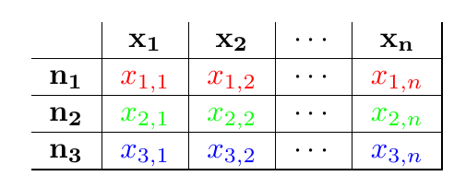
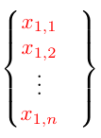
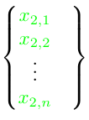
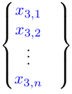
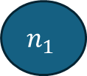
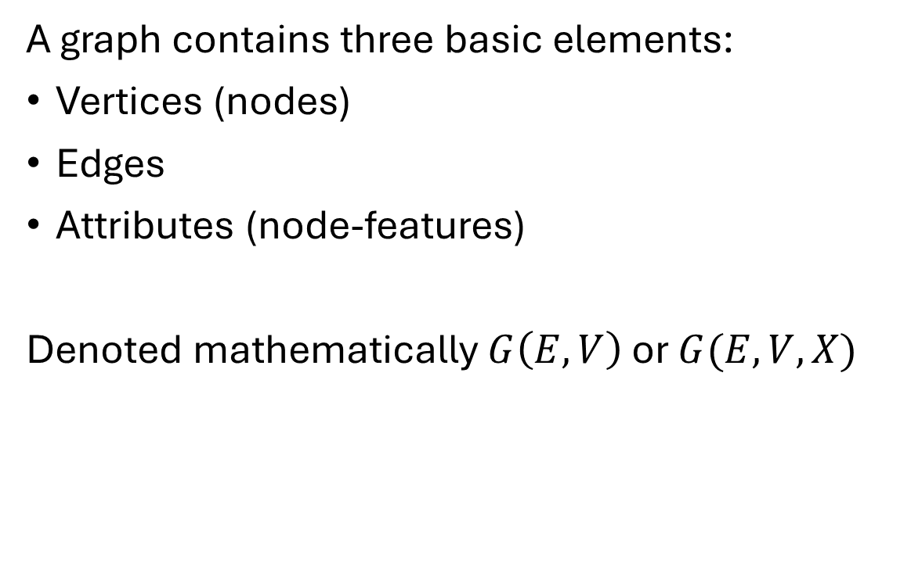
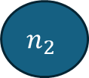
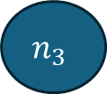
What is a graph?
A graph contains three basic elements:
Vertices (nodes)
Edges
Attributes (node-features)
Denoted mathematically $G\left(E,V\right)$ or $G(E,V,X)$
$$n_{1}$$
$$n_{2}$$
$$n_{3}$$

Slide 4
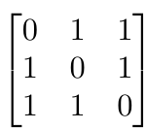
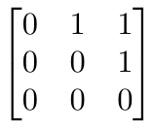
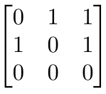
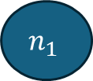

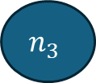


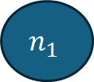

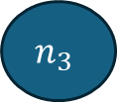
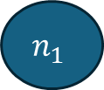

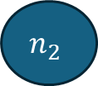

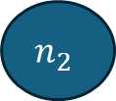
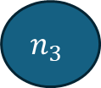

Structure Matters
Undirected
$$n_{1}$$
$$n_{2}$$
$$n_{1}$$
$$n_{2}$$
$$n_{3}$$
$$n_{1}$$
$$n_{2}$$
$$n_{3}$$
A graph can be
undirected (all edges are bidirectional)
directed (all edges are directional)
mixed (some directed and undirected edges)
Graphs are encoded as binary matrices called an Adjacency matrix
$$n_{3}$$
Directed
$$n_{1}$$
$$n_{2}$$
$$n_{3}$$
Mixed (partially directed)
$$n_{1}$$
$$n_{2}$$
$$n_{3}$$

Slide 5
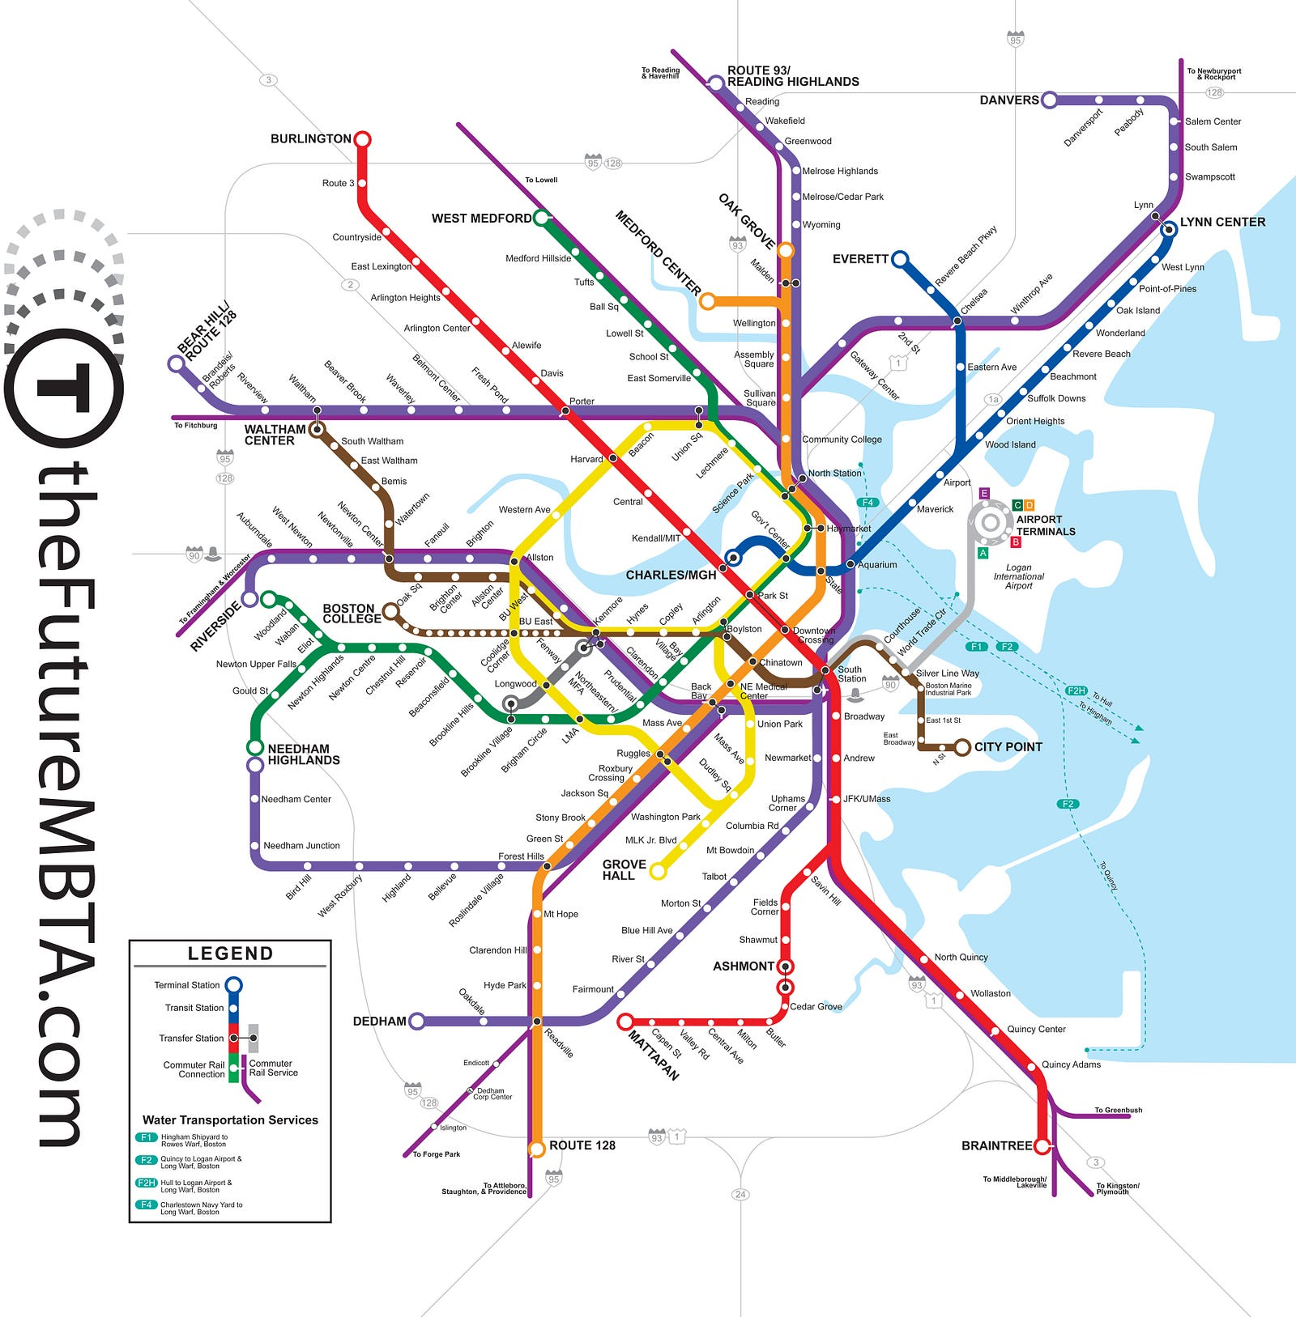
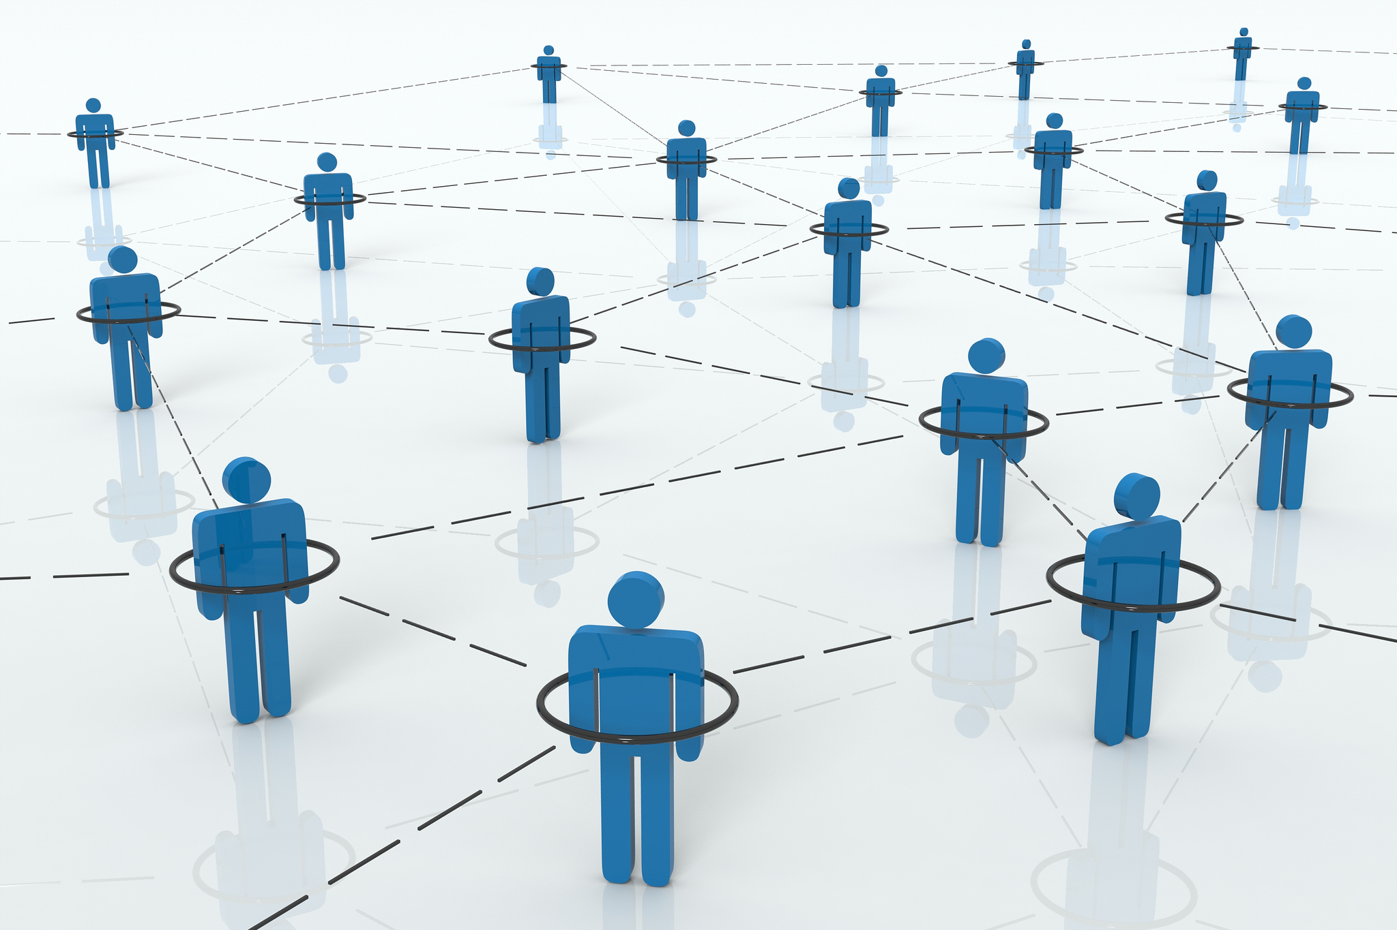
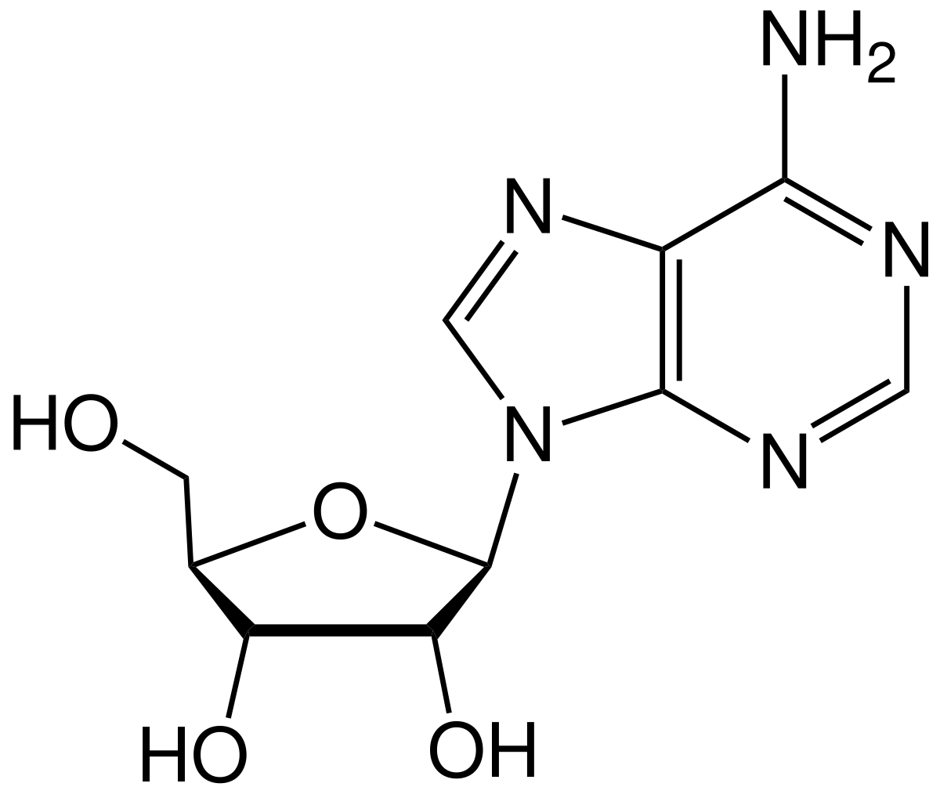
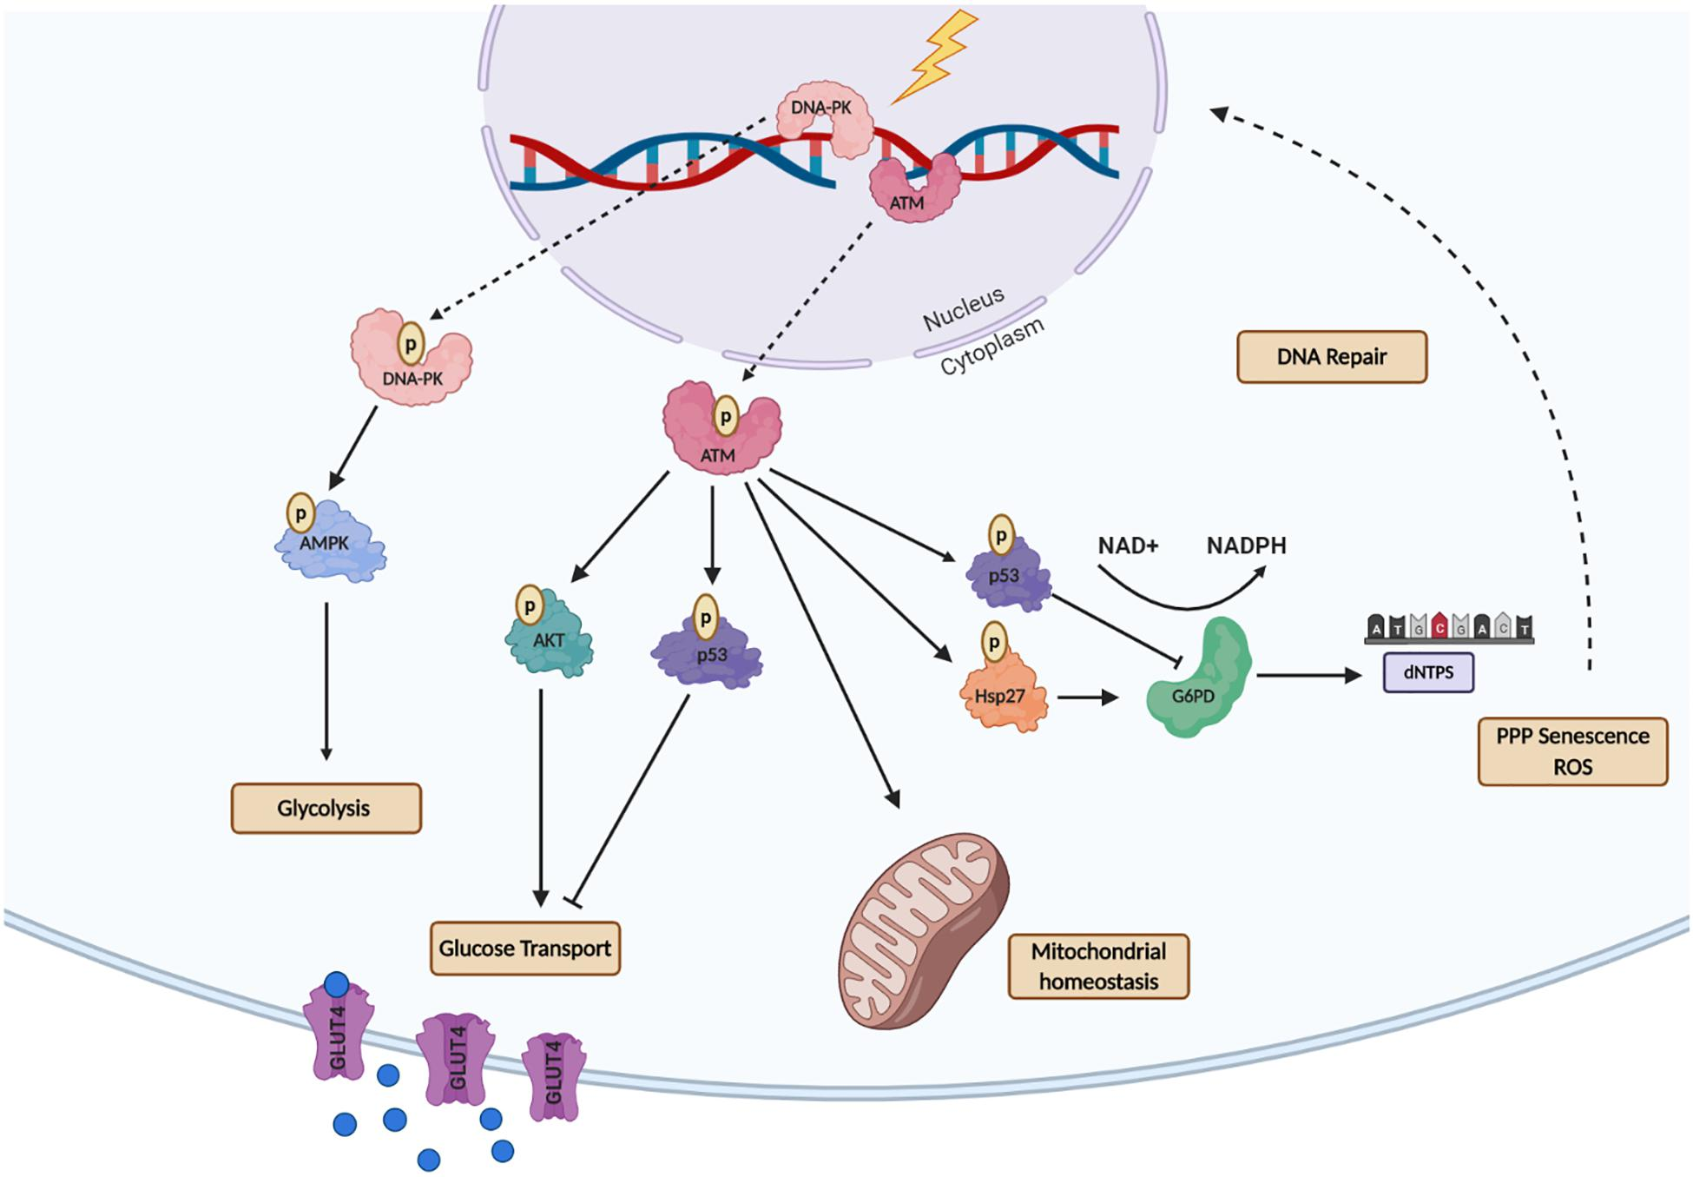
Graphs Are Everywhere!
Chemicals/molecules
Transportation networks
Social networks
Biological networks
Neural connectomes
Lots of different types of data can be represented as a graph!
Molecule

Slide 6
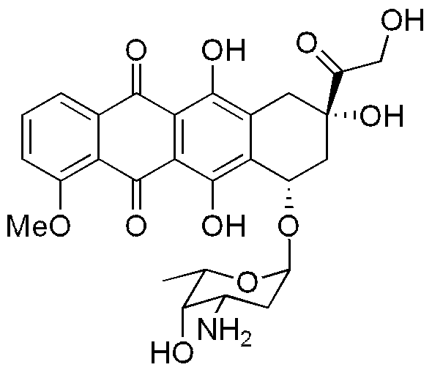


Ex. Drug Discovery
Molecules as graphs
Atoms as nodes, bonds between atoms as edges
Features could be atom type, bond type, charge …
Tasks: Binary prediction, classification
Ex. Predict whether molecule is potent as a drug to inhibit Cancer
Train model on curated dataset for compounds where response is known
Test on new drugs/compounds to determine their potency
GNN
doxorubicin

Slide 7
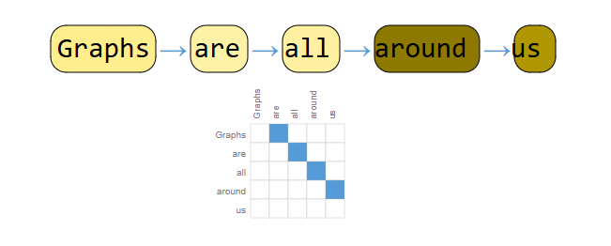
Connection between GNN and RNN
Recursive neural networks: specialized type of RNN that operates on structured hierarchical data, typically tree-like or graph-like structures
Can be thought of as a special case of GNN designed to deal with directed acyclic graphs
Specifically designed to process hierarchically structured data like parse trees in sentences

Slide 8
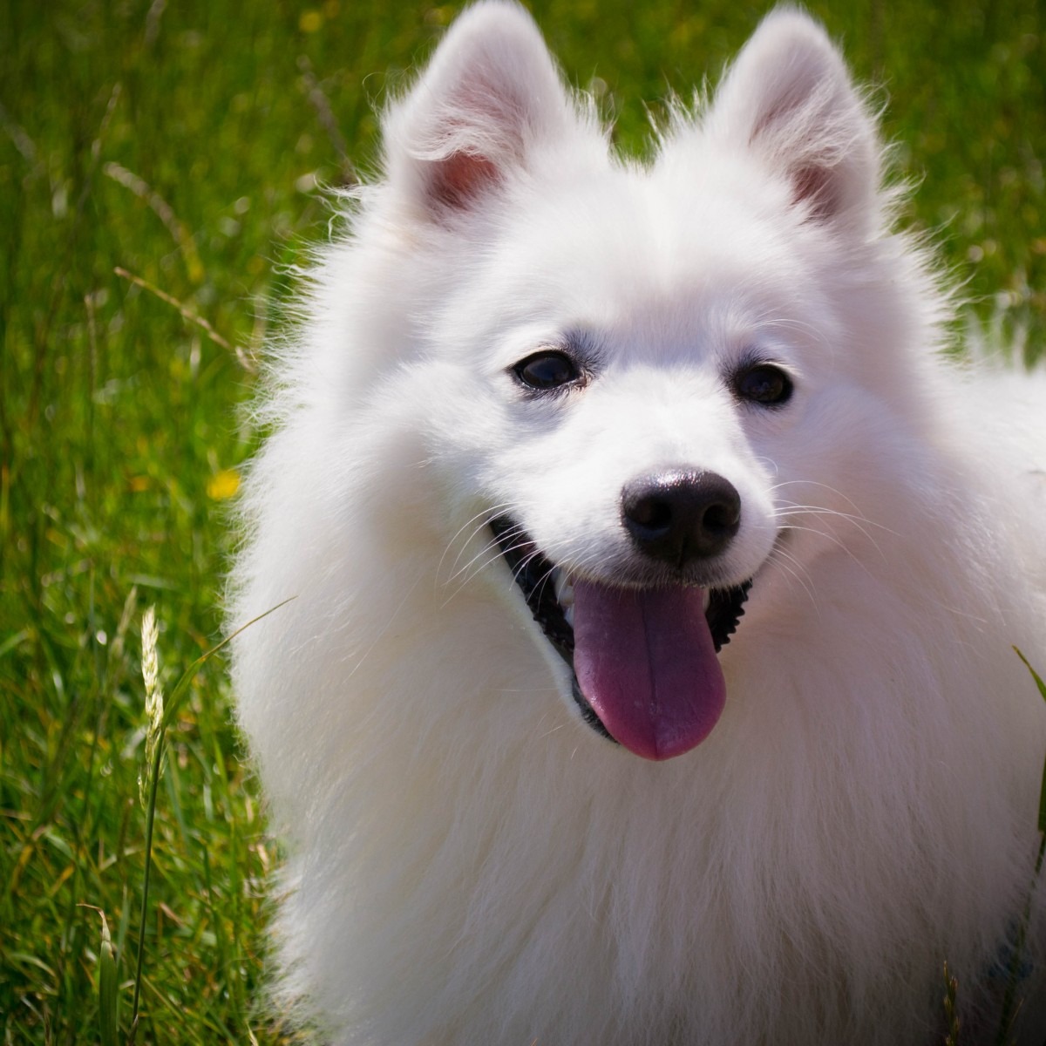
Connection between GNN and CNN
A graph can be thought of as a strict generalization of images
Any image can be represented by a “lattice” or “grid-like” graph
Each pixel is node and is connected to its adjacent pixels
p1
p2
p3
p4
p5
p6
p7
p8
p9
p10
p11
p12
p13
p14
p15
p16

Slide 9
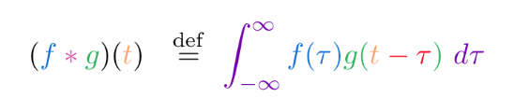


Connection between GNN and CNN
Image
Kernal
Output Image
1 | 1 | 0 | 1
1 | 1 | 0 | 0
0 | 0 | 0 | 1
1 | 1 | 0 | 0
2 | 1 | 0
1 | 1 | 1
1 | 0 | 0
1 | 0
0 | 1
$$∗$$
$$=$$
K
I*K
I

Slide 10



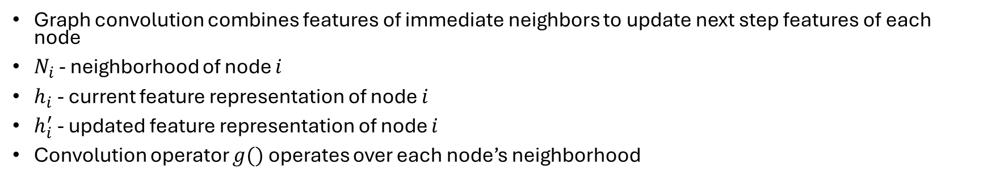






Graph Convolutional Network (GCN)
Graph convolution combines features of immediate neighbors to update next step features of each node
$N_{i}$ - neighborhood of node $i$
$h_{i}$ - current feature representation of node $i$
$h_{i}^{′}$ - updated feature representation of node $i$
Convolution operator $g()$ operates over each node’s neighborhood
$$h_{1}$$
$$h_{2}$$
$$h_{i}$$
$$h_{5}$$
$${h′}_{i}$$
$$h_{4}$$
$$h_{3}$$
$$h_{6}$$
$${h′}_{i}=g(h_{1}, h_{2}…h_{j}) ∀ j∈N_{i}$$

Slide 11
Properties of GCN
Desired:
Computational efficiency (~O(V+E))
Fixed parameter size (does not depend on input dimension
Operates on local information
Dynamic weighting of neighborhood information
Images have fixed regular structure making the convolution operation easy to implement
Generalizing to any graph structure of any size is the challenge!

Slide 12


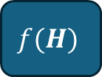


Tasks of GNN
Node, graph, or edge level classification
Node Clustering
Link Prediction
$$x_{i}$$
GNN
$$h_{i}$$
$$f(H)$$
Inputs: $X, A$
Latent outputs: $H, A$

Slide 13
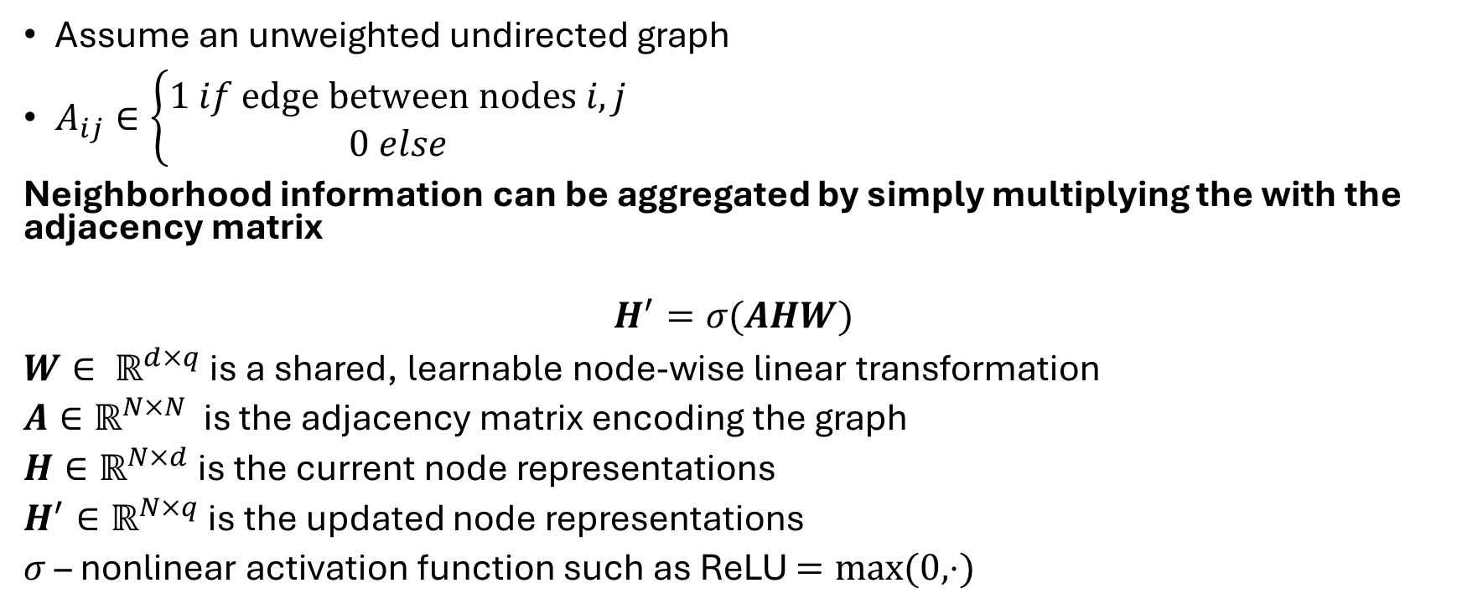
Defining Graph Convolution: Simple Update Rule
Assume an unweighted undirected graph
$A_{ij}∈\left\{\begin{aligned}1 if edge between nodes i, j \\ 0 else\end{aligned}\right.$
Neighborhood information can be aggregated by simply multiplying the with the adjacency matrix
$$H^{′}=σ(AHW)$$
$W∈ ℝ^{d×q}$ is a shared, learnable node-wise linear transformation
$A∈ℝ^{N×N}$ is the adjacency matrix encoding the graph
$H∈ℝ^{N×d}$ is the current node representations
$H^{′}∈ℝ^{N×q}$ is the updated node representations
$σ$ – nonlinear activation function such as ReLU $=max⁡(0, ⋅)$

Slide 14





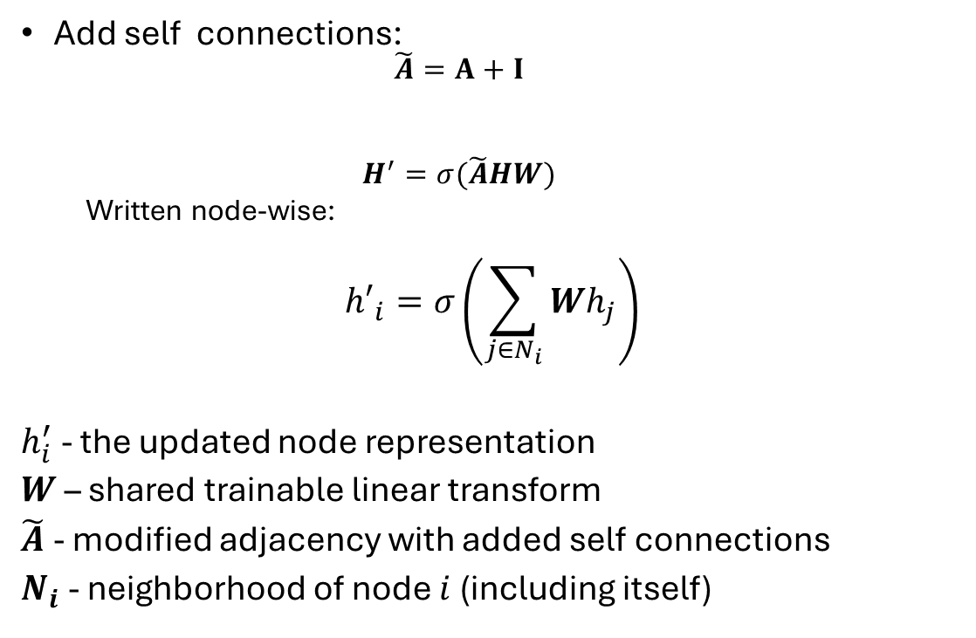







Some improvements
$$h_{1}$$
$$h_{2}$$
$$h_{1}$$
$$h_{2}$$
$$h_{3}$$
$$h_{3}$$
Add self connections:
$$\tilde{A}=A+I$$
$$H^{′}=σ(\tilde{A}HW)$$
Written node-wise:
$${h′}_{i}=σ\left(\sum_{j∈N_{i}}{Wh_{j}}\right)$$
$h_{i}^{′}$ - the updated node representation
$W$ – shared trainable linear transform
$\tilde{A}$ - modified adjacency with added self connections
$N_{i}$ - neighborhood of node $i$ (including itself)
0 | 1 | 1
1 | 0 | 1
1 | 1 | 0
1 | 0 | 0
0 | 1 | 0
0 | 0 | 1
1 | 1 | 1
1 | 1 | 1
1 | 1 | 1
$$+$$
$$=$$
$$A$$
$$I$$
$$\tilde{A}$$
$${h′}_{1}=g(h_{1}, h_{2}, h_{3})$$

Slide 15


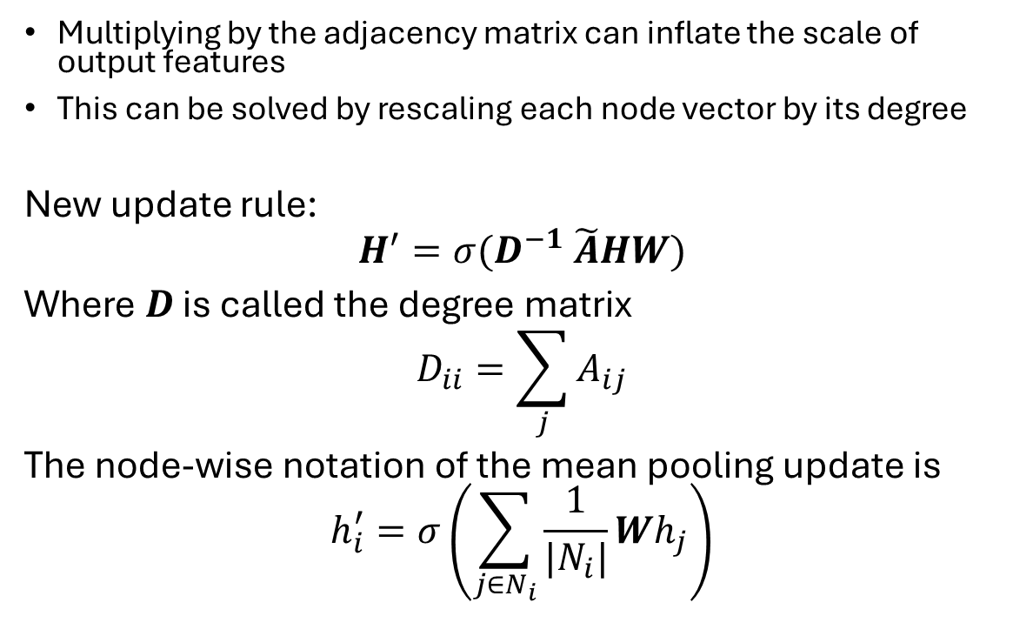



Mean Pooling Updates
$$h_{1}$$
$$h_{2}$$
Multiplying by the adjacency matrix can inflate the scale of output features
This can be solved by rescaling each node vector by its degree
New update rule:
$$H^{′}=σ(D^{−1} \tilde{A}HW)$$
Where $D$ is called the degree matrix
$$D_{ii}=\sum_{j}{A_{ij}}$$
The node-wise notation of the mean pooling update is
$$h_{i}^{′}=σ\left(\sum_{j∈N_{i}}{\frac{1}{|N_{i}|}Wh_{j}}\right)$$
$$h_{3}$$
0 | 1 | 1
1 | 0 | 1
1 | 1 | 0
$$A$$
2 | 0 | 0
0 | 2 | 0
0 | 0 | 2
$$D$$

Slide 16
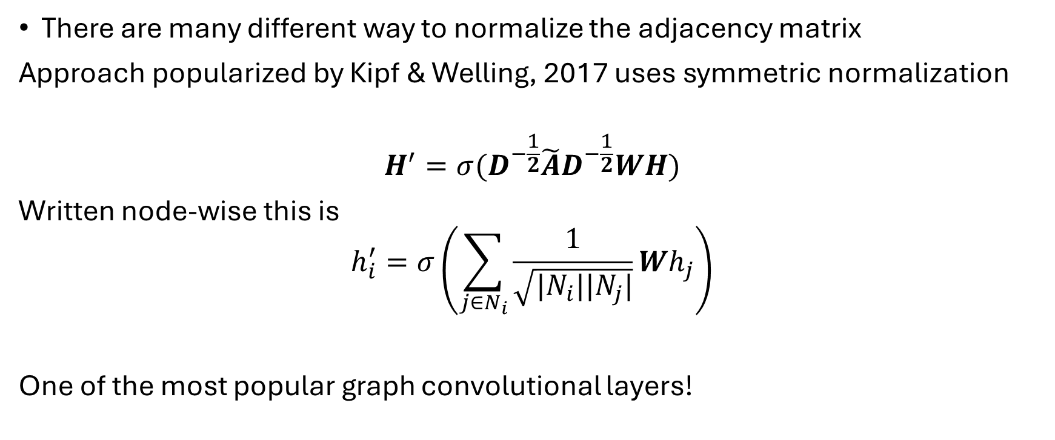
GCN (Kipf & Welling, ICLR 2017)
There are many different way to normalize the adjacency matrix
Approach popularized by Kipf & Welling, 2017 uses symmetric normalization
$$H^{′}=σ(D^{−\frac{1}{2}}\tilde{A}D^{−\frac{1}{2}}WH)$$
Written node-wise this is
$$h_{i}^{′}=σ\left(\sum_{j∈N_{i}}{\frac{1}{\sqrt{|N_{i}||N_{j}|}}}Wh_{j}\right)$$
One of the most popular graph convolutional layers!

Slide 17
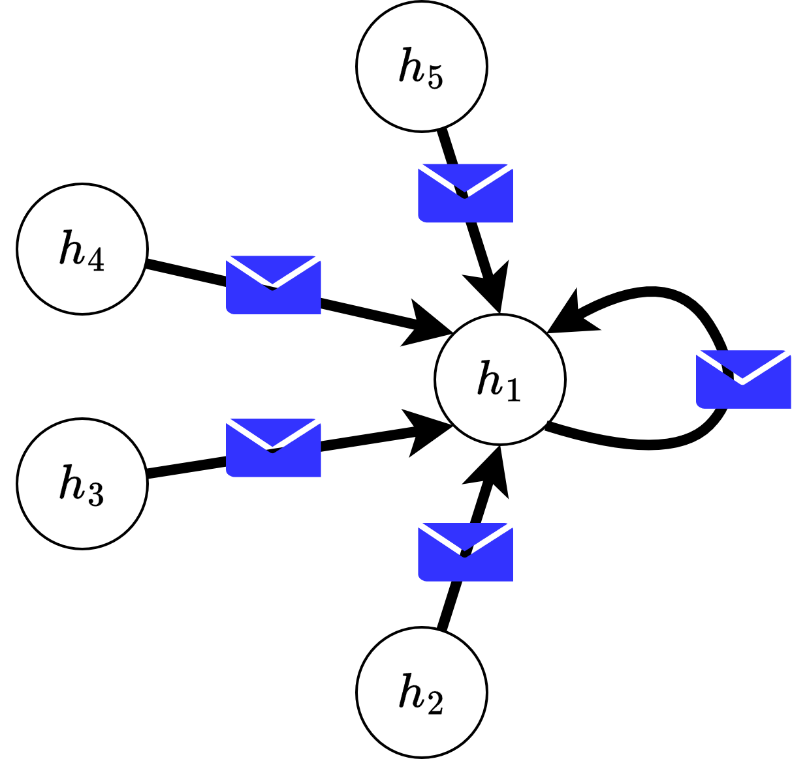
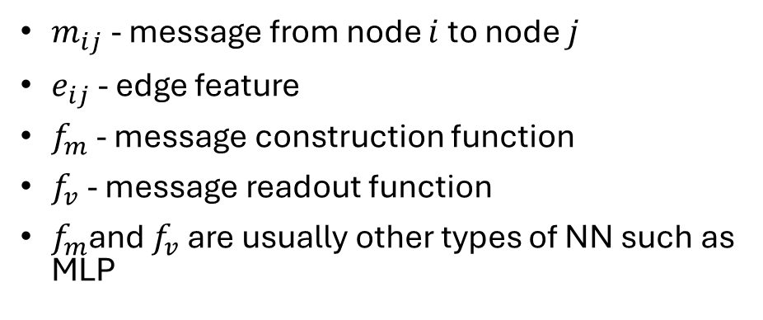
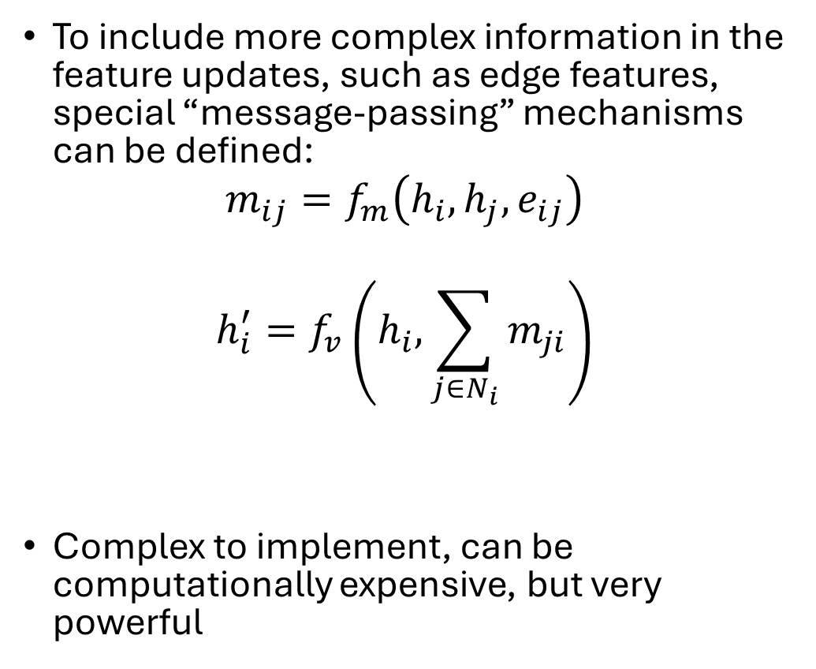
Supporting Edge Features: MPNN Gilmer et al, ICML 2017
To include more complex information in the feature updates, such as edge features, special “message-passing” mechanisms can be defined:
$$m_{ij}=f_{m}\left(h_{i}, h_{j}, e_{ij}\right)$$
$$h_{i}^{′}=f_{v}\left(h_{i}, \sum_{j∈N_{i}}{m_{ji}}\right)$$
Complex to implement, can be computationally expensive, but very powerful
$m_{ij}$ - message from node $i$ to node $j$
$e_{ij}$ - edge feature
$f_{m}$ - message construction function
$f_{v}$ - message readout function
$f_{m}$and $f_{v}$ are usually other types of NN such as MLP

Slide 18
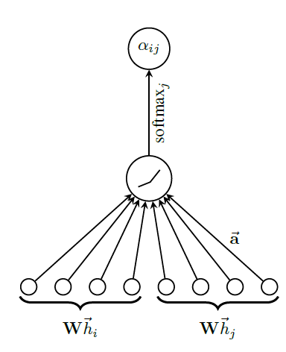
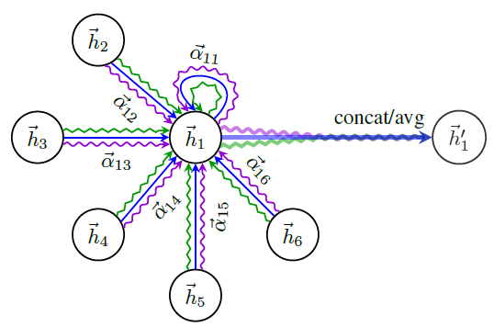
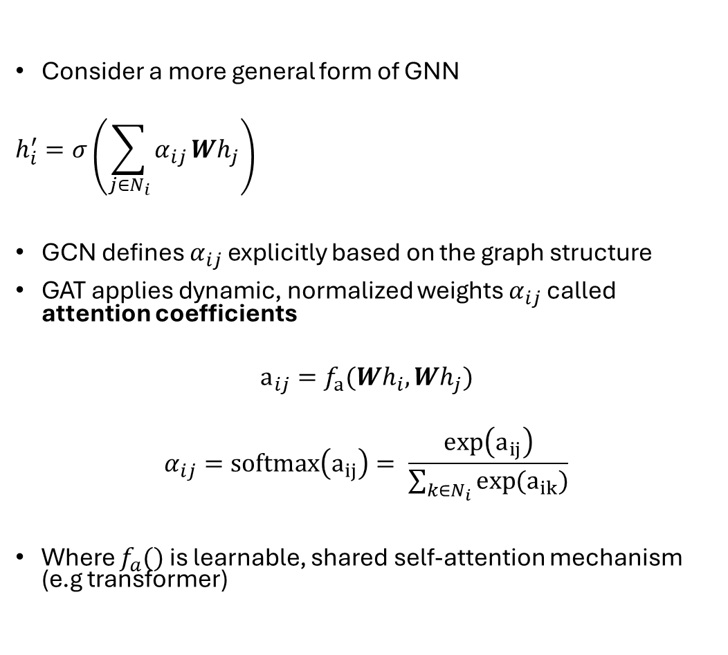
Graph Attention Neural Networks (Veličković et al. 2017 - Stat)
Consider a more general form of GNN
$$h_{i}^{′}=σ\left(\sum_{j∈N_{i}}{α_{ij}}Wh_{j}\right)$$
GCN defines $α_{ij}$ explicitly based on the graph structure
GAT applies dynamic, normalized weights $α_{ij}$ called attention coefficients
$$a_{ij}=f_{a}(Wh_{i}, Wh_{j})$$
$$α_{ij}=softmax\left(a_{ij}\right)= \frac{\exp\left(a_{ij}\right)}{\sum_{k∈N_{i}}{\exp{(a_{ik})}}}$$
Where $f_{a}()$ is learnable, shared self-attention mechanism (e.g transformer)

Slide 19
Accessing GNNs through pygeometric and Keras
TensorFlow Graph Neural Network (TF-GNN) Library
Built on top of tensorflow so integrates well with keras
pip install tensorflow-gnn
Documentation: https://github.com/tensorflow/gnn
Multiple types of GNN layers
Pygeometric –
Comprehensive, built on top of pytorch
Many types of GNN layer including GAT, GCN, GraphSAGE, others
Cuda compatible
pip install torch-geometric
Documentation: https://pytorch-geometric.readthedocs.io/en/latest/

Slide 20
My Research
Gene Regulatory Network
V
T1
T4
Gene regulatory networks (GRNs) are essential models for understanding molecular mechanisms governing cellular identity, function, and disruption in genetic disease
Represented as a graph where
nodes are genes/other biological elements
edges are interactions between genes/elements
node features are molecular measurements such as gene transcription
If you can accurately model a system, then you can manipulate it!
T2
T3
V
Nodes representing genetic variants
T
Nodes representing genes
T1
T2
Expression of T1 correlated with expression of T2
T1 regulates T2 (a change in T1 causes a proportional change in T2)
T1
T2

Slide 21
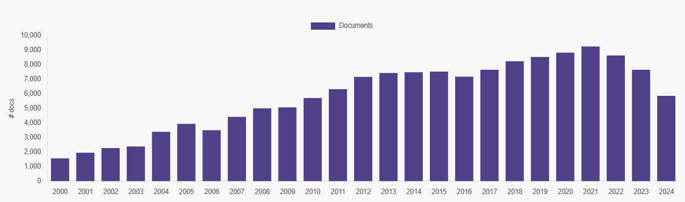
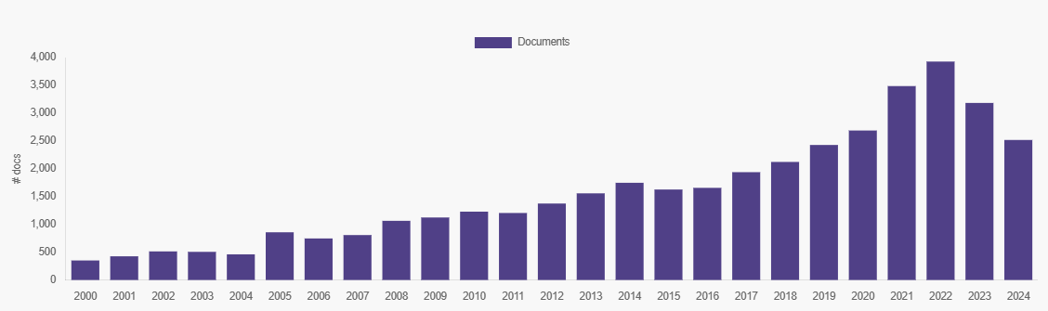
Publication Trends in Health and Biological Sciences with keyword “gene regulatory network”
Publication Trends in Health and Biological Sciences with keyword “graph neural networks”
These figures were created using constellate.org

Slide 22
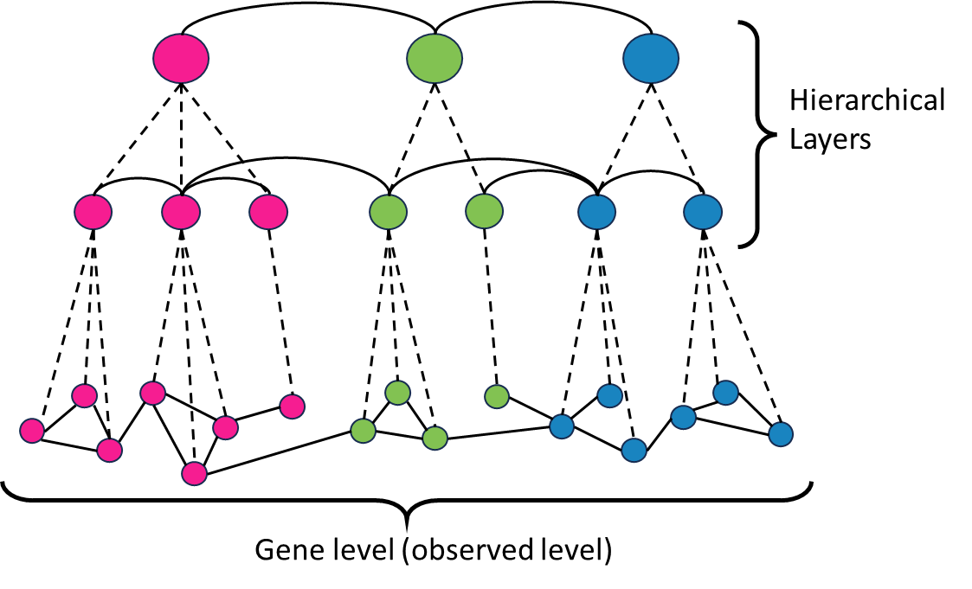
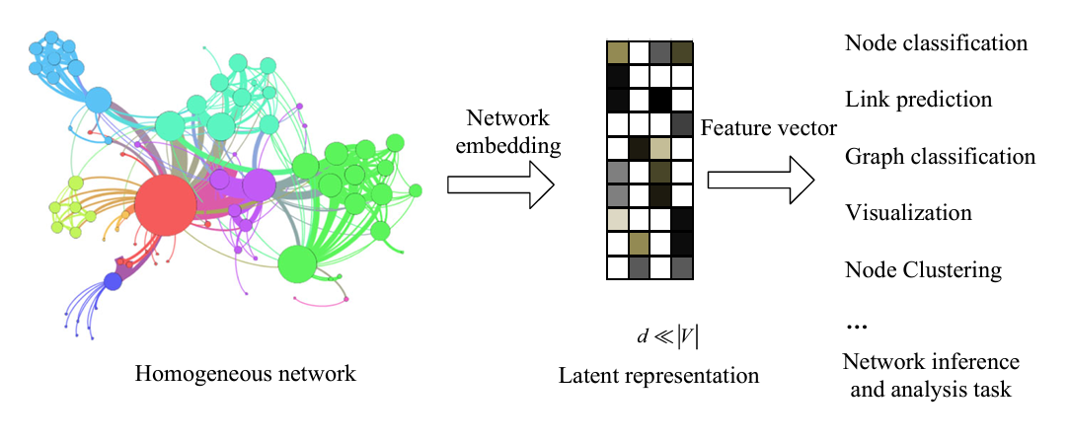
Challenges
Many genes in the genome…
Goal: Partition genes into communities according to their functional relationships in order to simplify the large GRNs and learn higher order regulatory structure
Representation learning – A machine learning technique that allows machines to automatically identify and learn the most useful features from raw data
Adapted from Li and Pi (2019) – Neural Computing and Applications

Slide 23
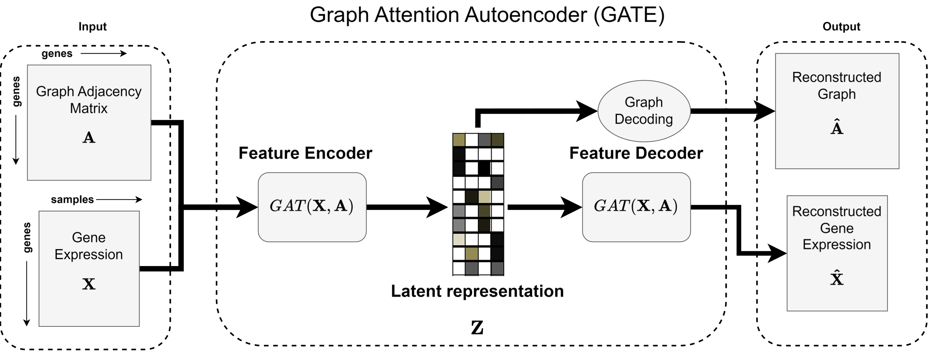
Model Architecture – Feature Embedding Model

Slide 24
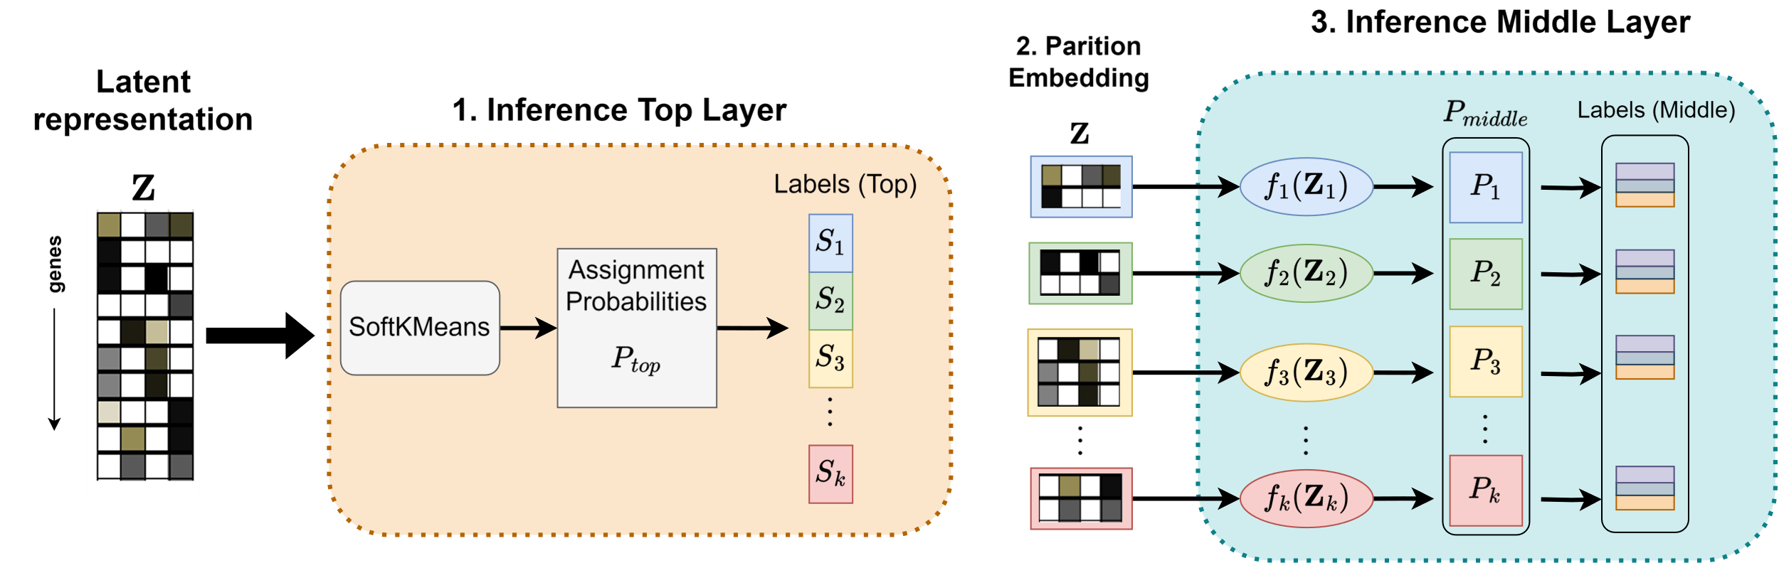
Model Architecture – Inference Model
1
Top layer cluster assignments obtained from SoftKMeans
2
Genes are partitioned according to cluster assignment
Each partition is passed a specific model which tries to partition it into finer clusters
3

Slide 25
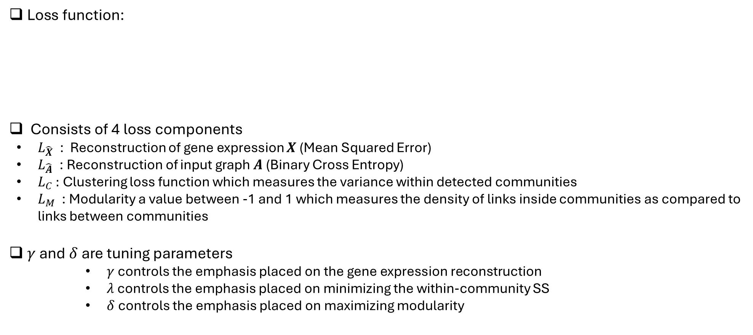
Loss Function
Loss for feature
embedding model
Loss for inference model
Loss function:
Consists of 4 loss components
$L_{\hat{X}}$ : Reconstruction of gene expression $X$ (Mean Squared Error)
$L_{\hat{A}}$ : Reconstruction of input graph $A$(Binary Cross Entropy)
$L_{C}$ : Clustering loss function which measures the variance within detected communities
$L_{M}$ : Modularity a value between -1 and 1 which measures the density of links inside communities as compared to links between communities
$γ$ and $δ$are tuning parameters
$γ$ controls the emphasis placed on the gene expression reconstruction
$λ$ controls the emphasis placed on minimizing the within-community SS
$δ$ controls the emphasis placed on maximizing modularity
Notes:
We ran a subset of simulations to investigate the impact of model misspecification
We looked at four scenarios:
In all scenarios,

